Slide 1
Chronic Kidney Disease Classification
Mentored By
Prof. Ahmad Taher Azar
Done by
Yousef Al Asfar
Abdulrahman Saleh

Slide 2

TABLE OF CONTENTS
01
02
03
Background
Data Exploration
Preprocessing/Cleaning
04
05
Modeling
Conclusion
Chronic kidney disease causes and symptoms
Data Dictionary - Visualization - Statistical Analysis
Null Value Handling
KNN - Logistic Regression
Results

Slide 3
01
Background

Slide 4
What is Chronic Kidney Failure
Chronic kidney disease/failure: is the gradual loss of kidney function.
In the early stages, you might have few signs or symptoms. You might not realize that you have kidney disease until the condition is advanced.
The kidneys filter wastes and excess fluids from your blood
Kidney disease can cause dangerous levels of fluid, electrolytes and wastes to build up in your body.

Slide 5
Chronic Kidney disease Symptoms
Nausea
Vomiting
Loss of appetite
Fatigue and weakness
Sleep problems
Urinating more or less
Decreased mental sharpness
Muscle cramps
Swelling of feet and ankles
Dry, itchy skin
High blood pressure (hypertension) that's difficult to control
Shortness of breath, if fluid builds up in the lungs
Chest pain, if fluid builds up around the lining of the heart

Slide 6
Chronic Kidney disease Symptoms
Type 1 or type 2 diabetes
High blood pressure
Interstitial nephritis, an inflammation of the kidney's tubules
Polycystic kidney disease
inherited kidney diseases
Prolonged obstruction of the urinary tract, from conditions such as enlarged prostate, kidney stones and some cancers
Vesicoureteral reflux, a condition that causes urine to back up into your kidneys
Recurrent kidney infection, also called Pyelonephritis

Slide 7
Risk factors of Kidney diseases
Diabetes
High blood pressure
Heart (cardiovascular) disease
Smoking
Obesity
Being Black, Native American or Asian American
Family history of kidney disease
Abnormal kidney structure
Older age
Frequent use of medications that can damage the kidneys

Slide 8

Data Exploration
02

Slide 9
Data Shape
Features
24
Records
400
Number of attributes of the classification including the target
Number of rows in the dataset

Slide 10
Data Dictionary
AGE
BP
SG
AL
FLT: Float
NOM: Nominal
Patient’s Age
Blood Pressure in mm/Hg
FLT
FLT
Specific Gravity: Urine concentration 1.005
Albumin: manages fluids (0,1,2,3,4,5)
NOM
NOM

Slide 11
Data Dictionary
RBC
PC
PCC
BA
Red Blood Cells (normal,abnormal)
Pus Cells: infection in urine (normal,abnormal)
NOM
NOM
Pus Cells Clumps (present,notpresent)
Bacteria (present, notpresent)
NOM
NOM

Slide 12
Data Dictionary
BGR
BU
SC
SOD
Blood Glucose Random mgs/dl
Blood Urea: blood presence in urea mgs/dl
FLT
FLT
Serum Creatinine: kidney wellness mgs/dl
Sodium mEq/L
FLT
FLT

Slide 13
Data Dictionary
POT
HEMO
PCV
WC
Potassium mEq/L
Hemoglobin gms
FLT
FLT
Packed Cell Volume: RBC volume cells/cumm
White Blood Cell millions/cmm
FLT
FLT

Slide 14
Data Dictionary
RC
HTN
DM
CAD
Red Blood Cells
millions/cmm
Hypertension (yes,no)
FLT
NOM
Diabetes Mellitus (yes,no)
Coronary Artery Disease: oxygen shortage (yes,no)
NOM
NOM

Slide 15
Data Dictionary
Appet
PE
ANE
SU
Appetite (good,poor)
Pedal edema: fluid accumulation (yes,no)
NOM
NOM
Anemia (yes,no)
Sugar (0,1,2,3,4,5)
NOM
NOM

Slide 16
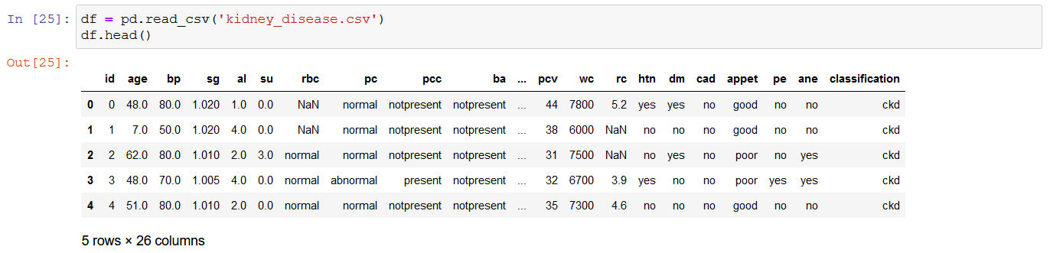
Importing The Data

Slide 17
Unique Values
BP
DM
PVC
[ 80. 50. 70. 90. nan 100. 60. 110. 140. 180. 120.]
['44' '38' '31' '32' '35' '39' '36' '33' '29' '28' nan '16’ '24' '37' '30'
'34' '40' '45' '27' '48' '\t?' '52' '14' '22' '18' '42' '17' '46' '23' '19' '25' '41' '26' '15' '21' '43' '20' '\t43' '47' '9' '49' '50' '53' '51' '54']
[ 'no' ' yes' '\tno' '\tyes' nan ]

Slide 18
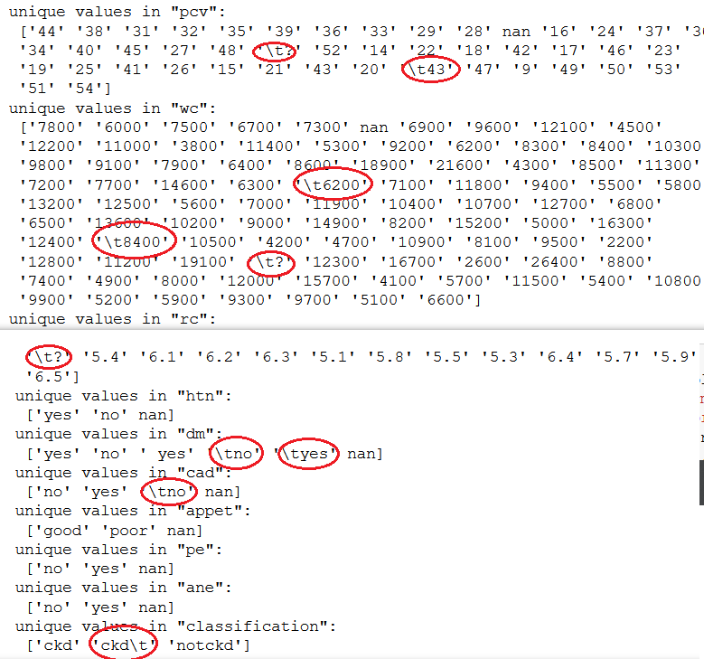
Checking Unique Values
The data needs some cleaning before we use it!

Slide 19
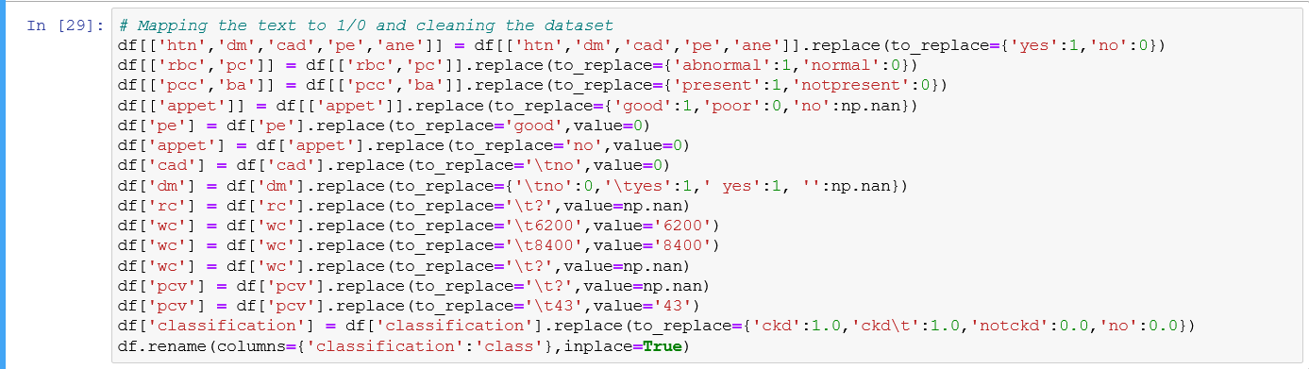
Cleaning the Dataset

Slide 20

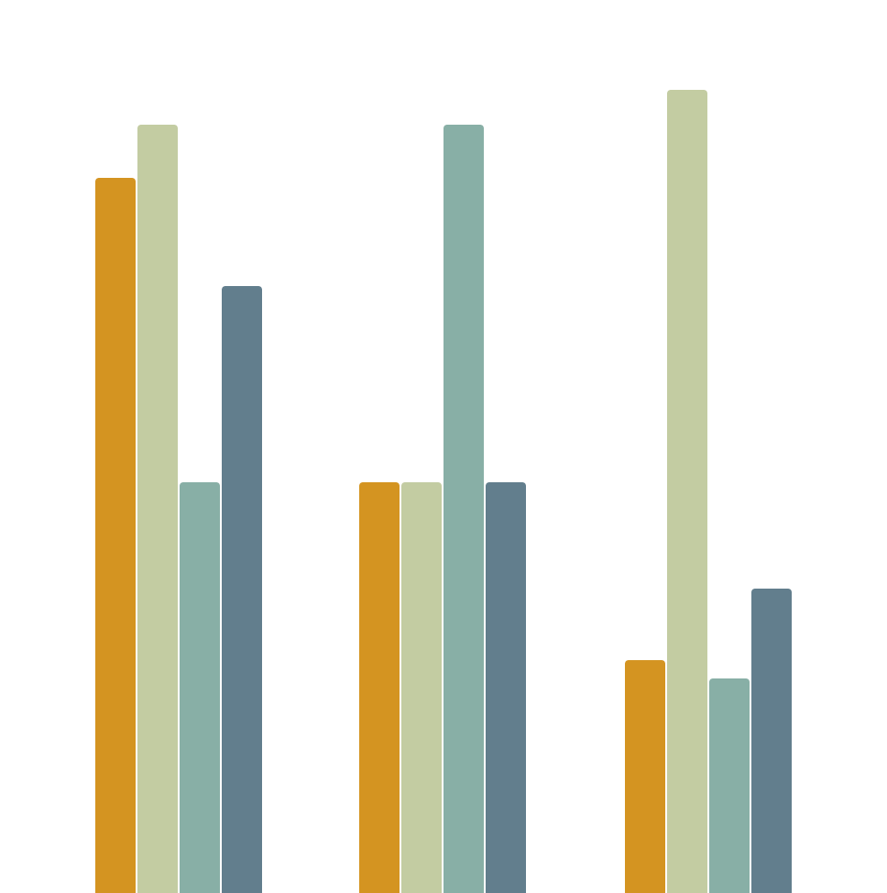
STATS IN DEPTH
MEAN
MDDE
VAR
MIN MAX
Feature 1
Feature 2
Feature 3

Slide 21
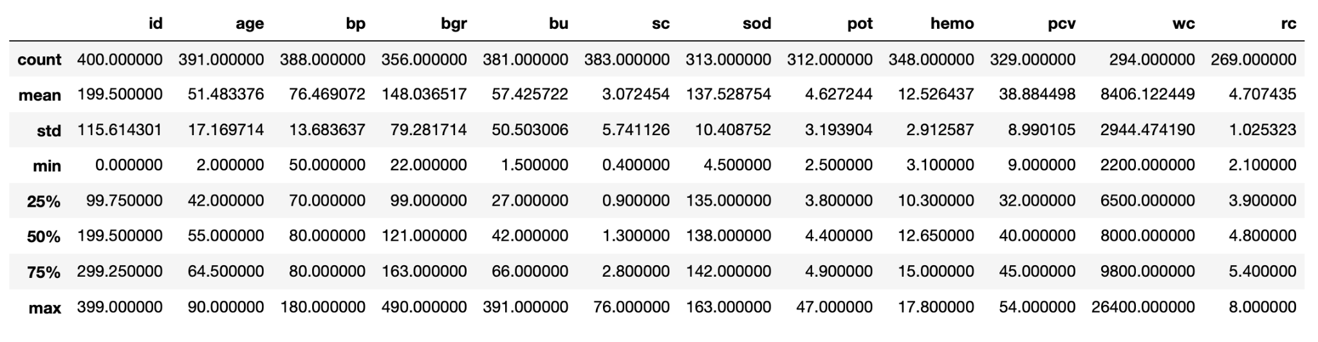
Data Description

Slide 22
Categorical Mode

Slide 23
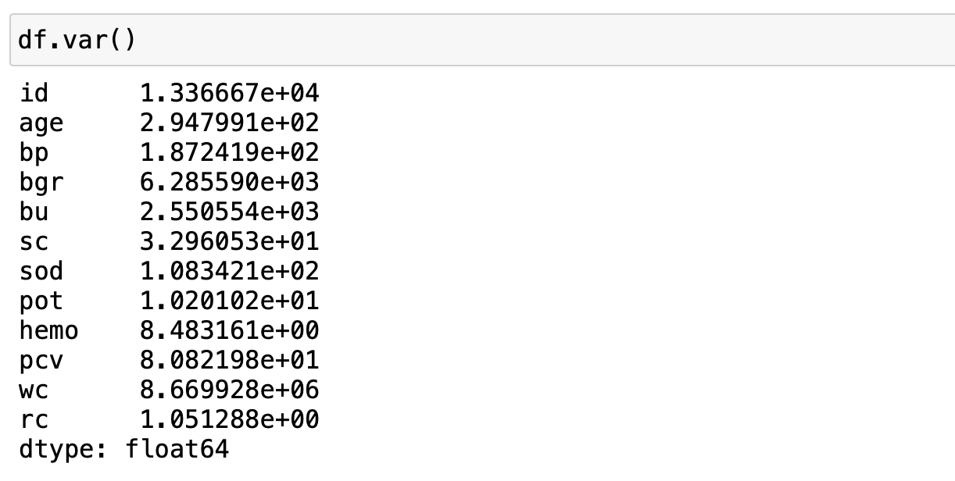
Variance

Slide 24

Outliers
AGE
Blood Pressure
Blood Glucose Random
Blood Urine
Serum Creatinine
Sodium
6 outliers
34 outliers
42 outliers
37 outliers
46 outliers
18 outliers

Slide 25
Outliers
Potassium
Hemoglobin
Packed Cell Volume
White blood Cells
18 outliers
1 outliers
7 outliers
17 outliers

Slide 26
Data Visualization
03

Slide 27
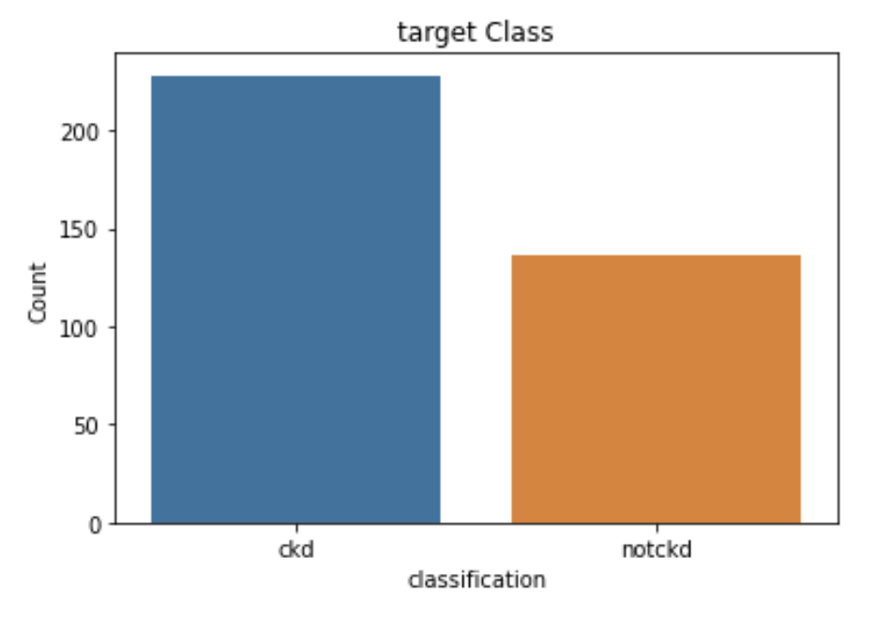
Target Distribution

Slide 28
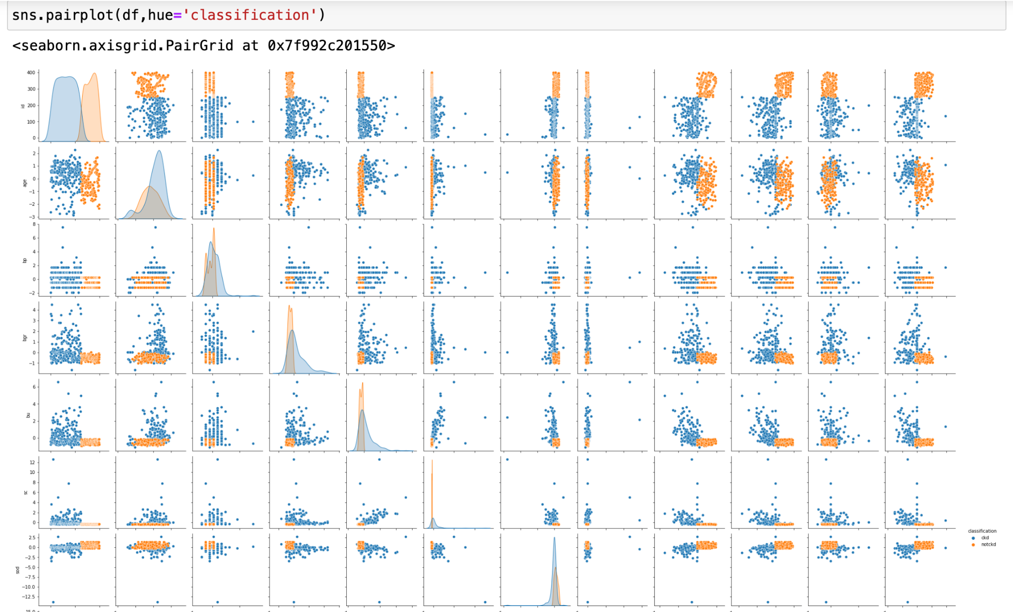
Pair Plot Graph

Slide 29
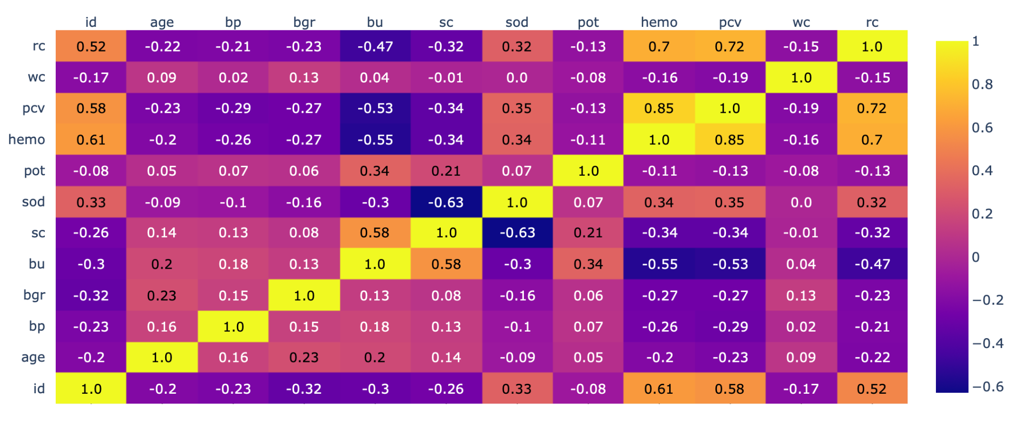
Features Correlation
HEMO - RC
HEMO - PCV
RC - PCV

Slide 30
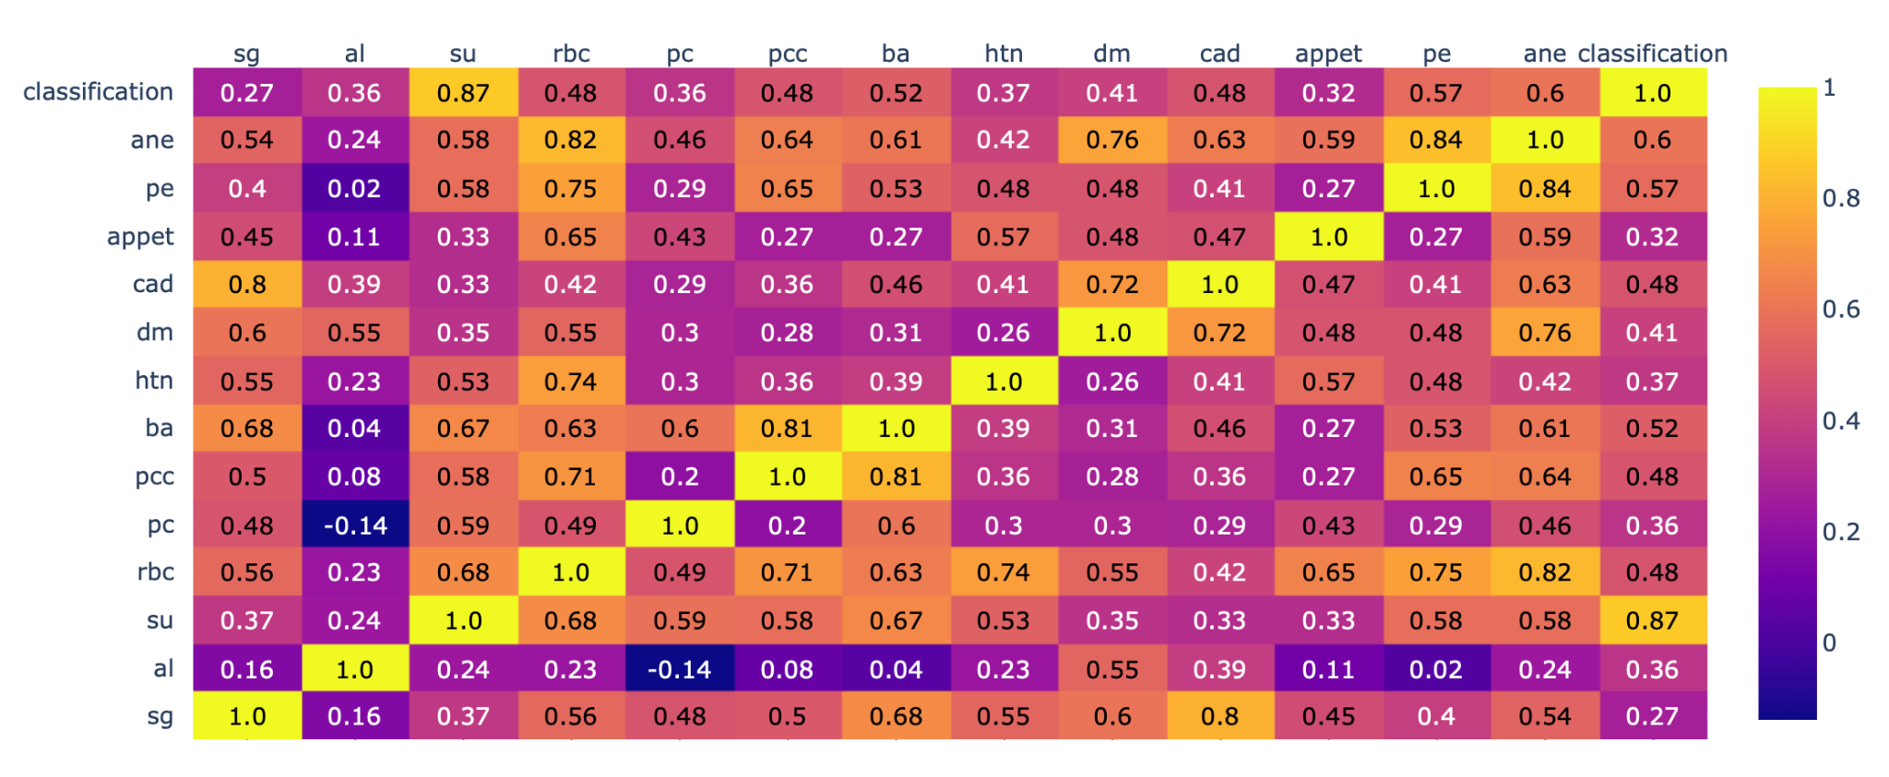
Target Correlation
Sugar
Anemia
Pedal Edema
Bacteria
Red Blood Cells

Slide 31

PLOTS

Slide 32
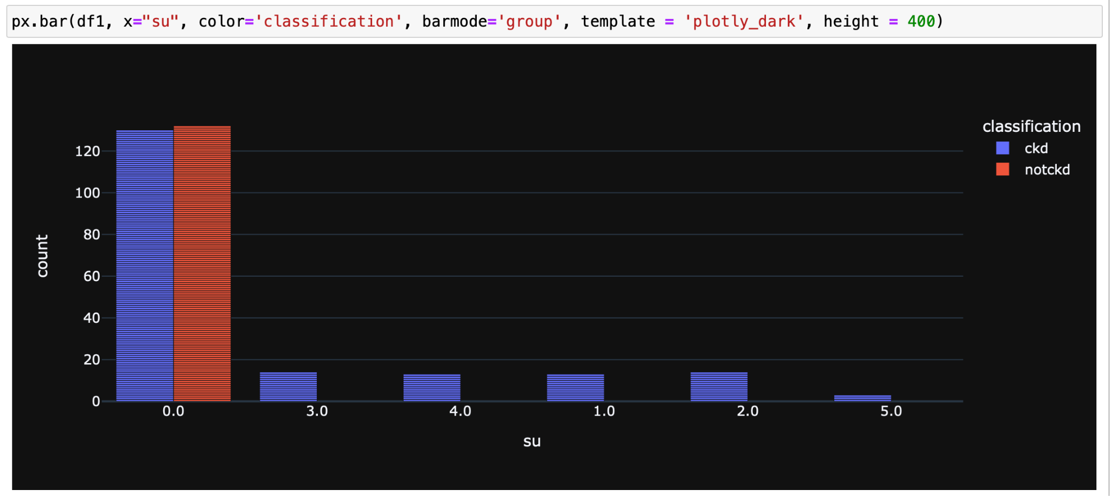
Sugar Bar Chart

Slide 33
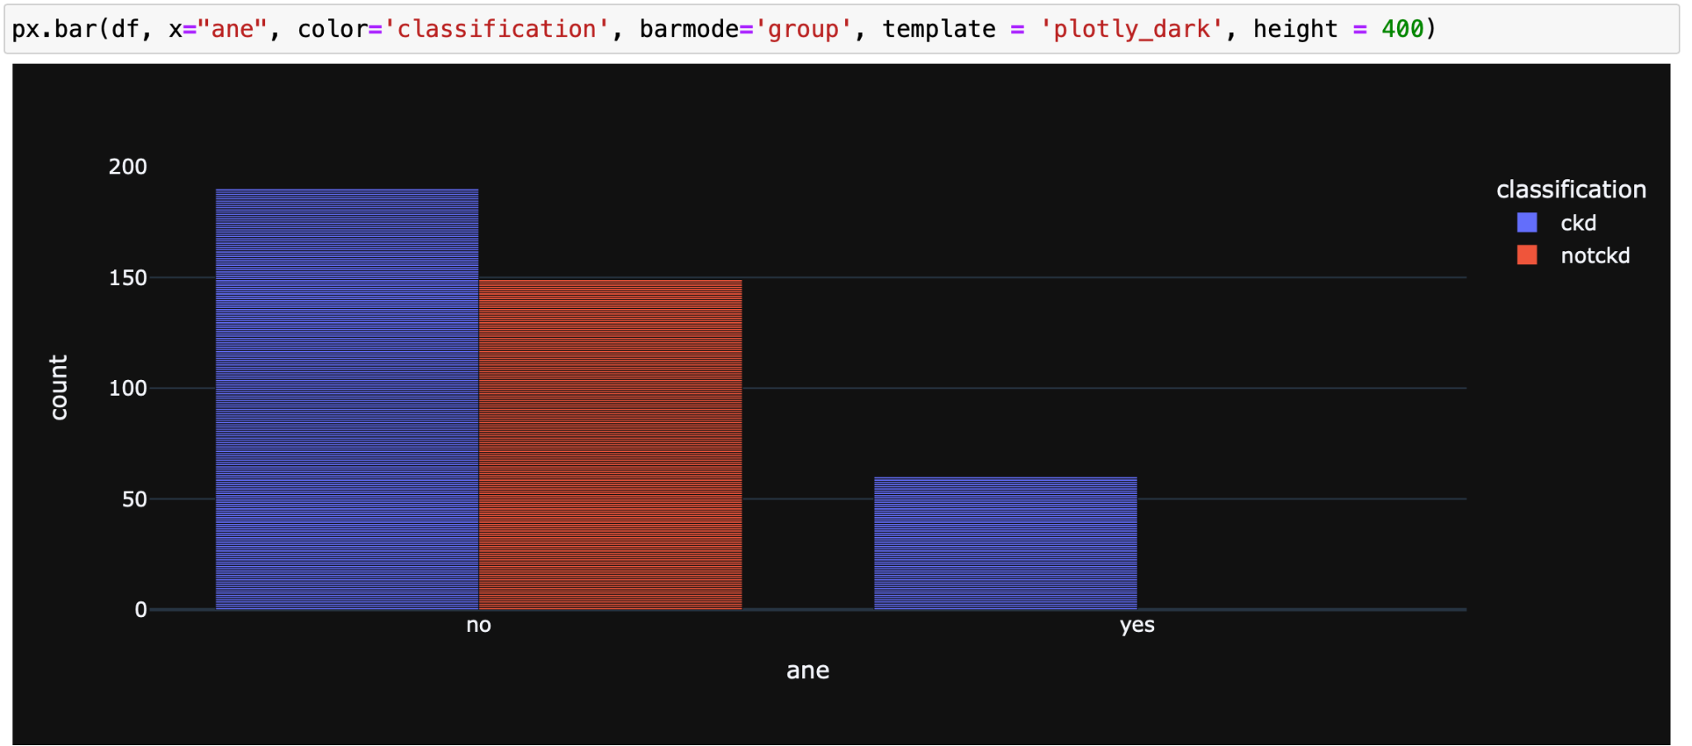
Anemia Bar Chart

Slide 34
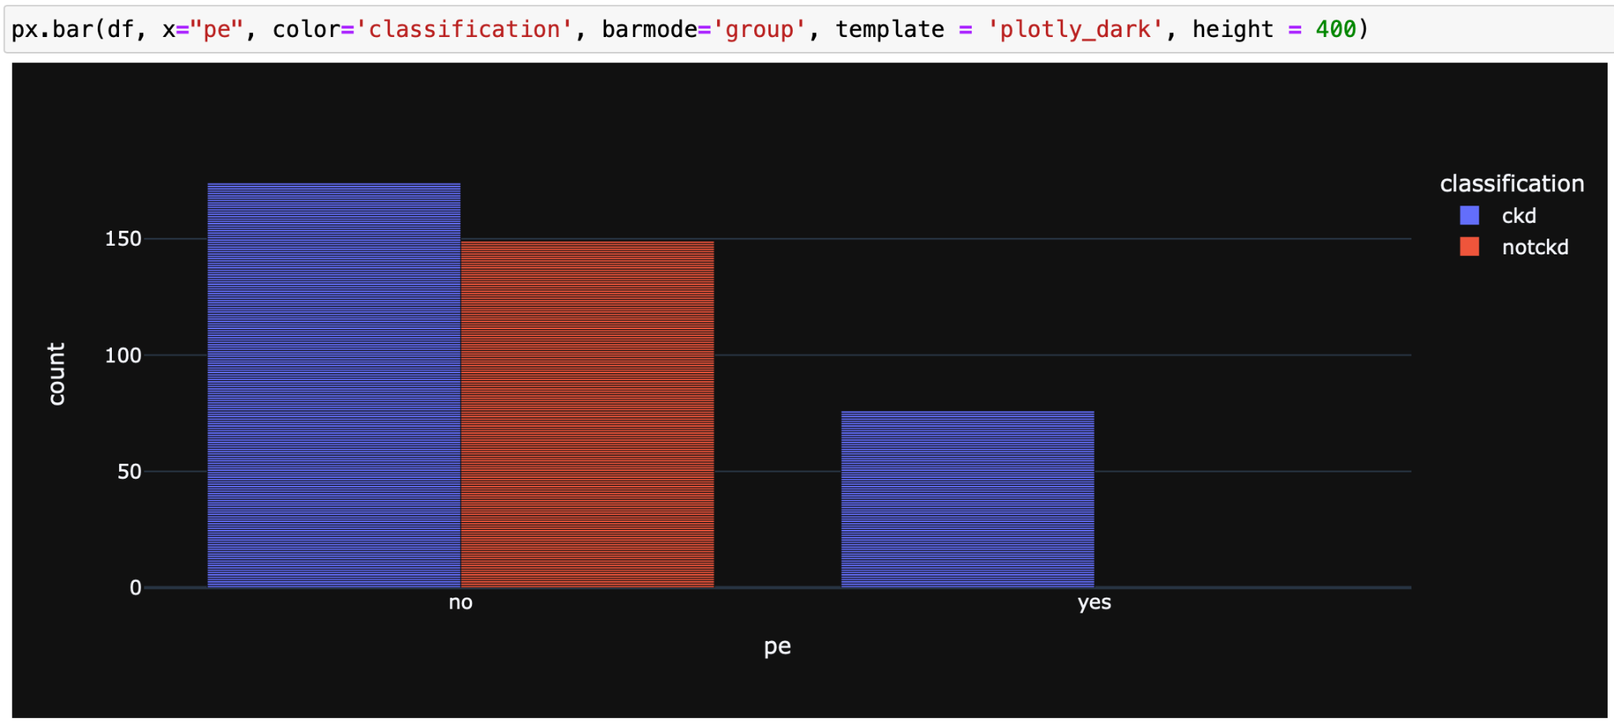
Pedal Edema Bar Chart

Slide 35
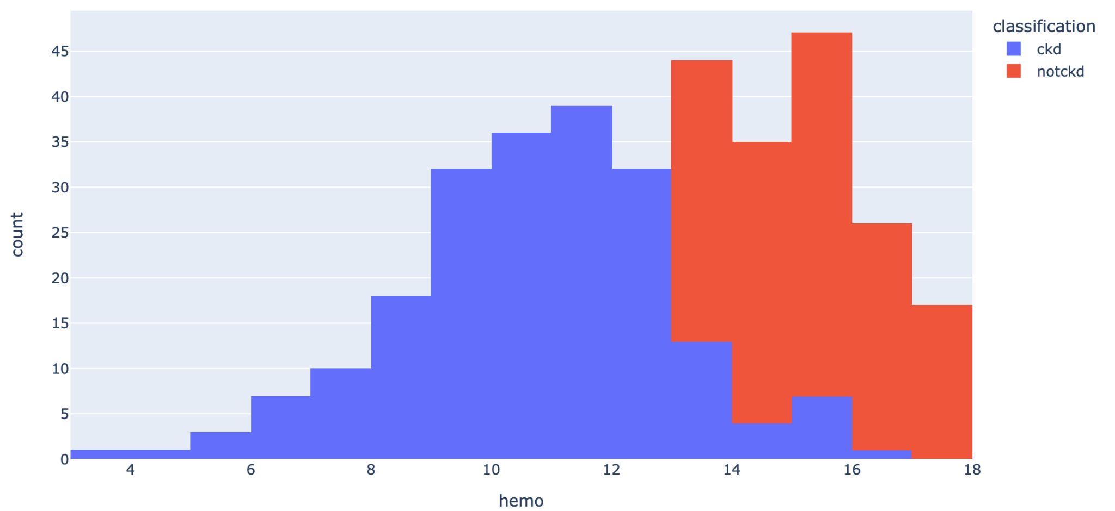
Hemoglobin Histogram

Slide 36
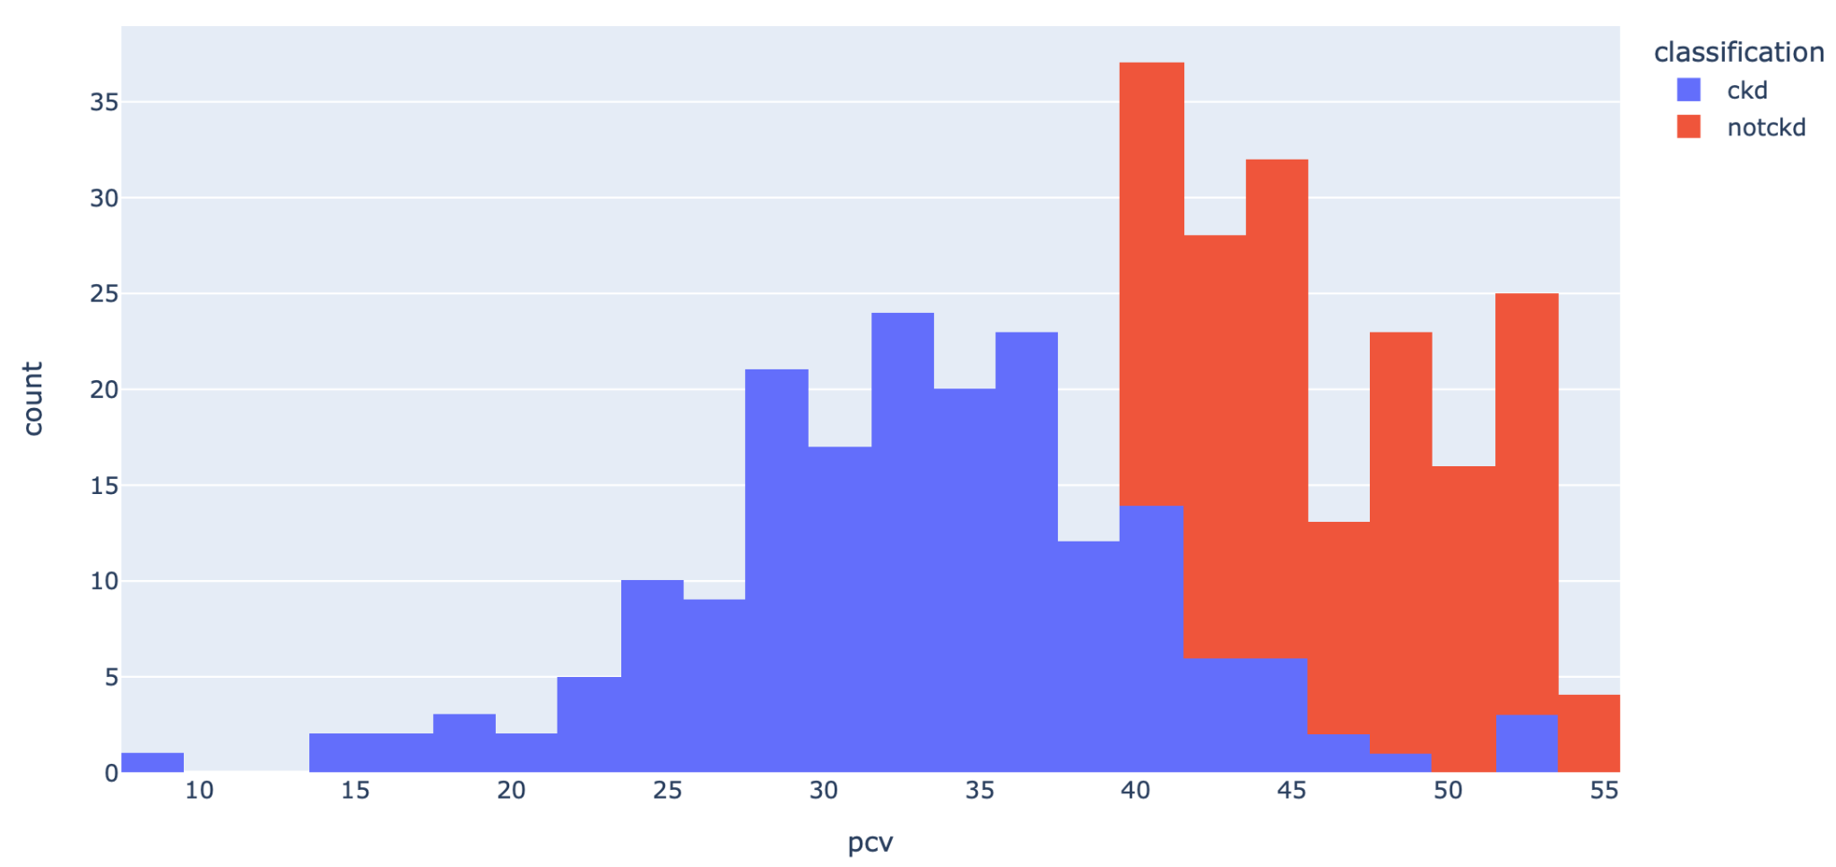
Packed Cell Volume Histogram

Slide 37
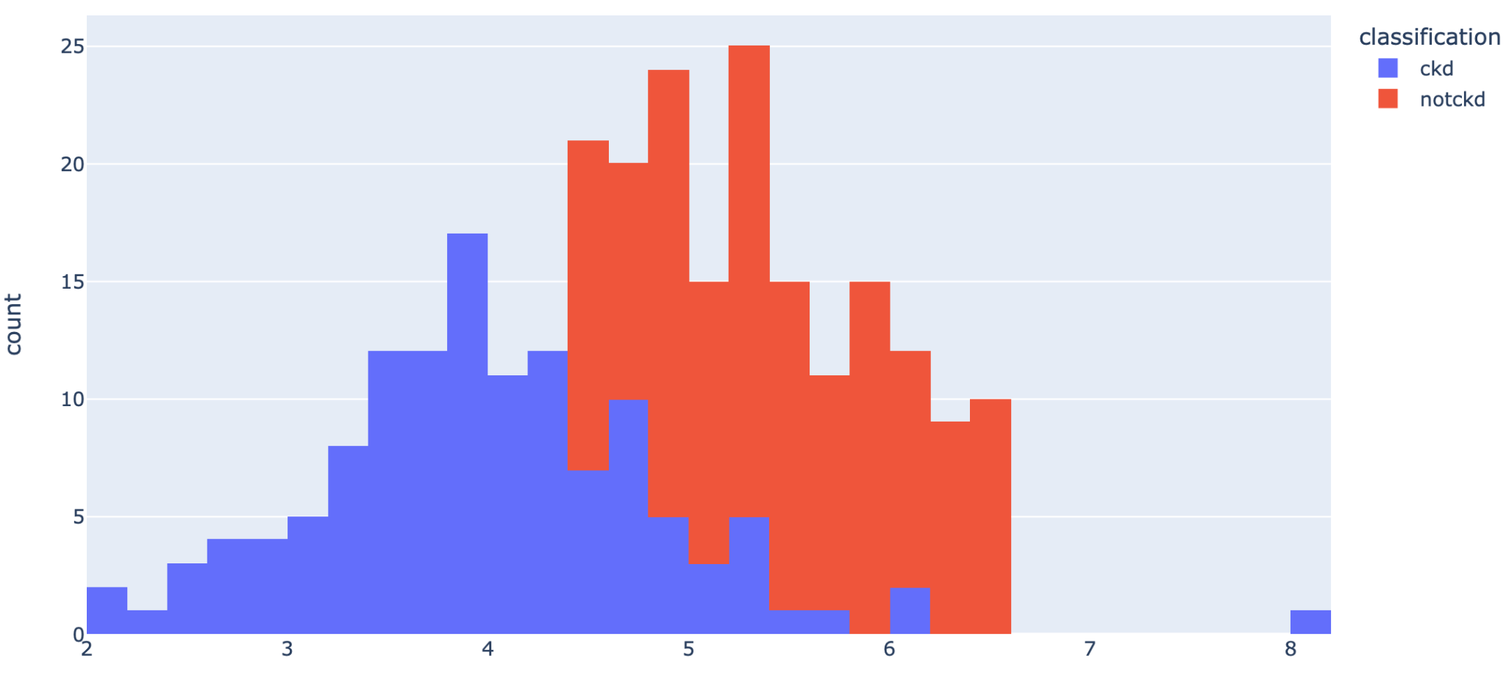
Red Blood Cell Histogram

Slide 38
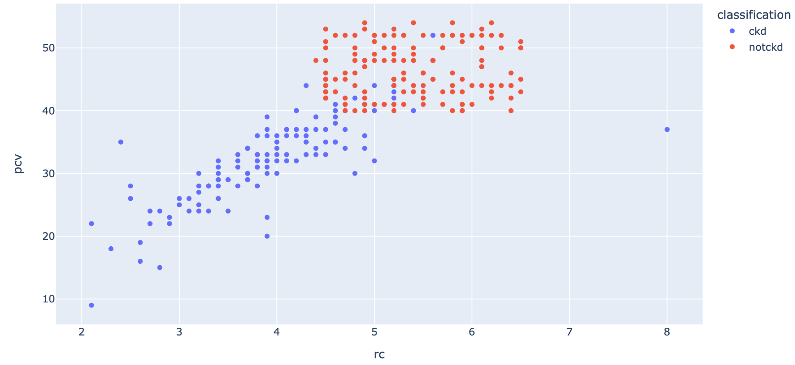
Packed Cells - Red Blood Cell Scatter

Slide 39
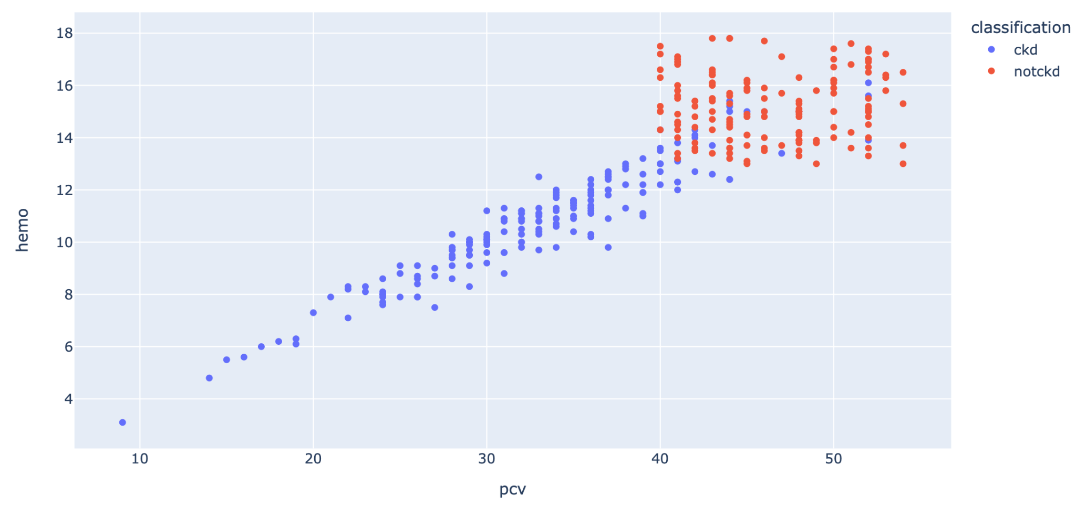
Hemo - Red Blood Cell Scatter

Slide 40
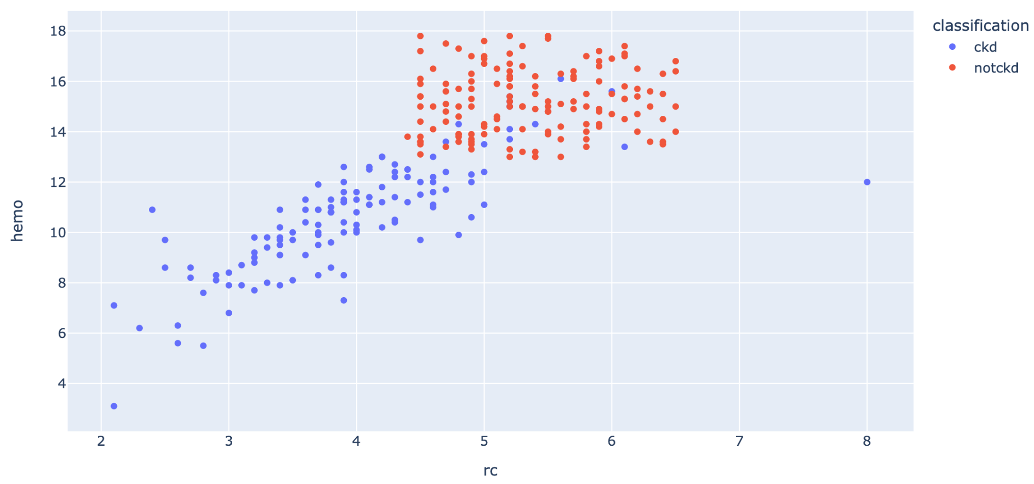
Hemo - Red Blood Cell Scatter

Slide 41

Preprocessing
04
Null values - Deleted values

Slide 42
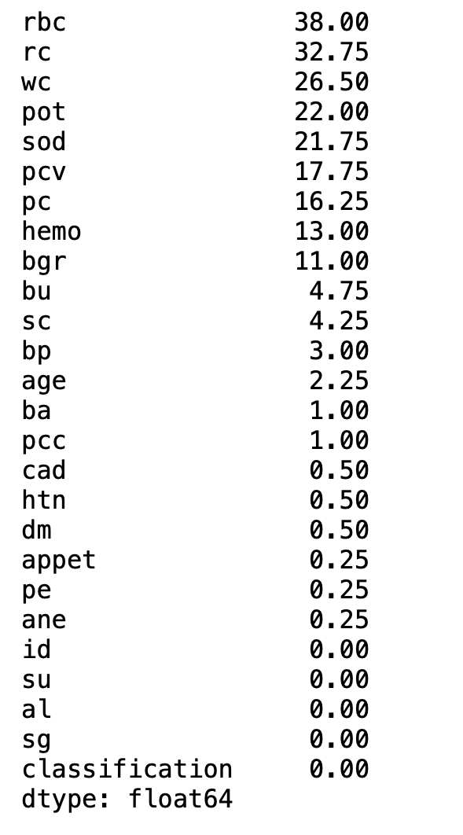
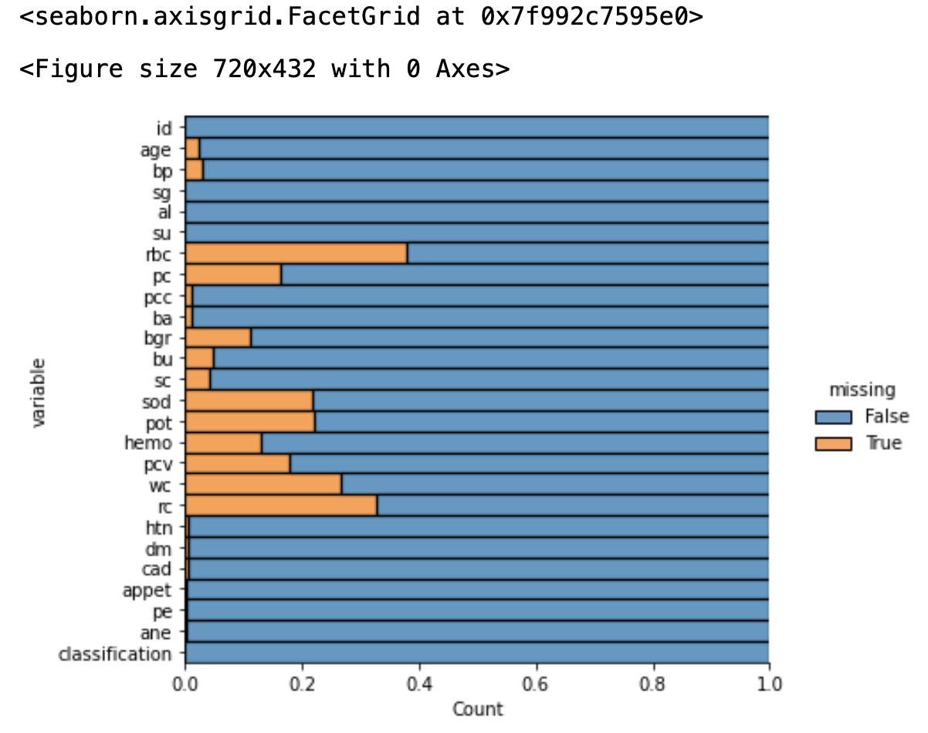
Null Values

Slide 43
Data Shape
Features
26
Records
364
Number of attributes of the classification including the target
Number of rows in the dataset

Slide 44
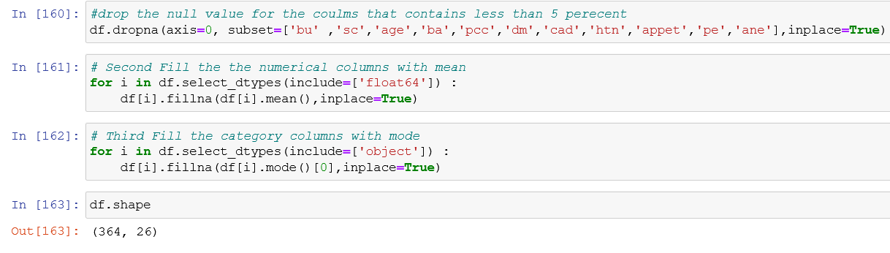
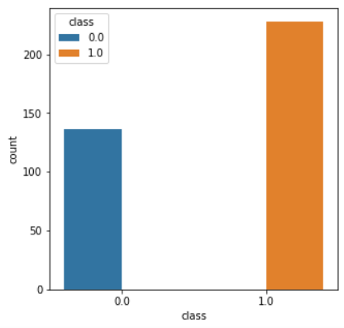
Handling Null Values

Slide 45

05
Modeling
KNN, Logistic Regression, and Decision Trees

Slide 46
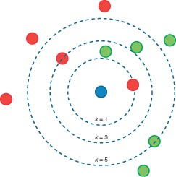
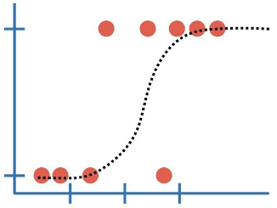
Models We Will Use
Logistic Regression
Nearest Neighbour KNN

Slide 47
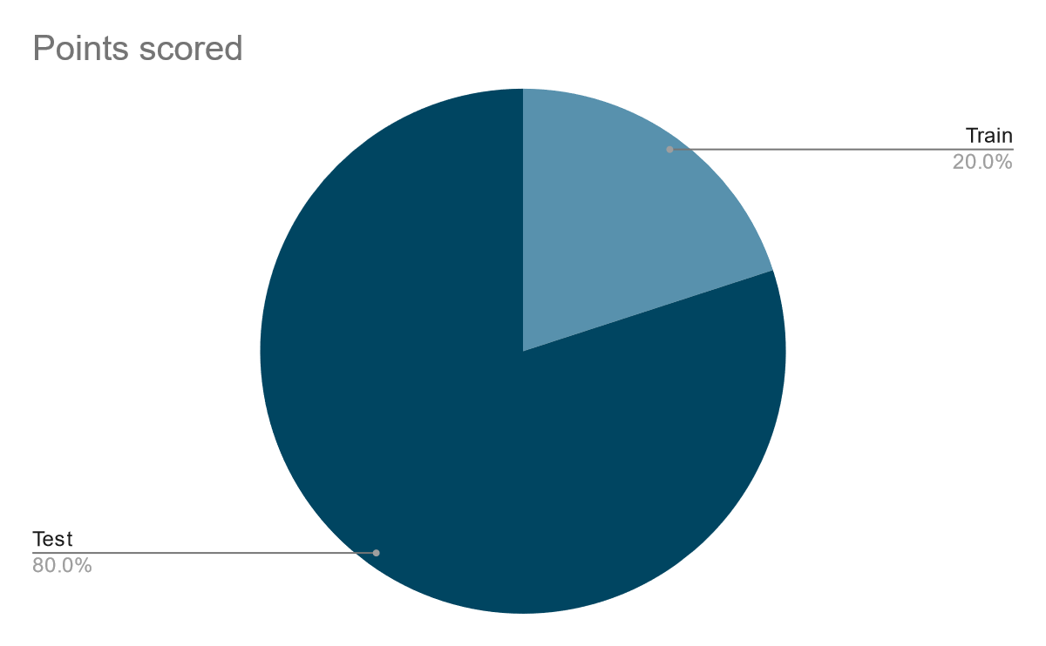
Splitting Our Data
Random State = 42
Cross Validation Value = 5
Tune the hyperparameter by looping method
Decision Tree Leaf Size = 10, 20, 30, 40, 50
Find Best K Values = 1 - 50

Slide 48
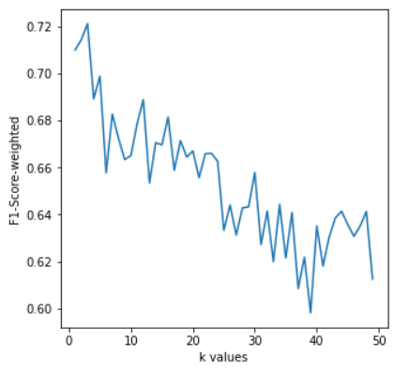
Without Normalization
Optimal K = 3

Slide 49
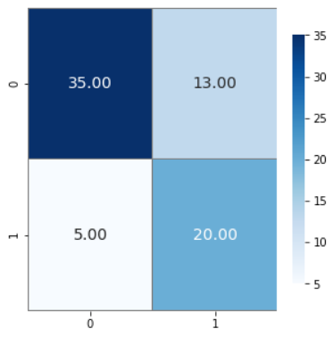
Confusion Matrix
 | Precision | Recall | F1 Score | Support
Not CKD | 0.61 | 0.60 | 0.69 | 25
CKD | 0.88 | 0.73 | 0.80 | 48
Accuracy |  |  | 0.75 | 73
Macro Avg | 0.74 | 0.76 | 0.74 | 73
Weighted Avg | 0.76 | 0.75 | 0.76 | 73

Slide 50
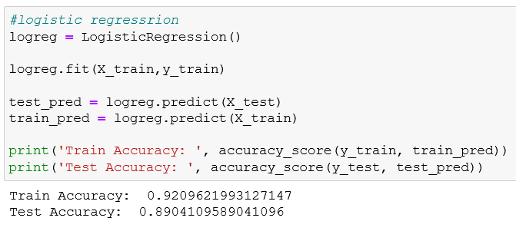
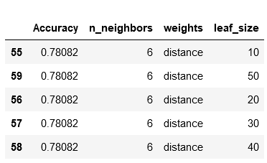
Without Normalization

Slide 51
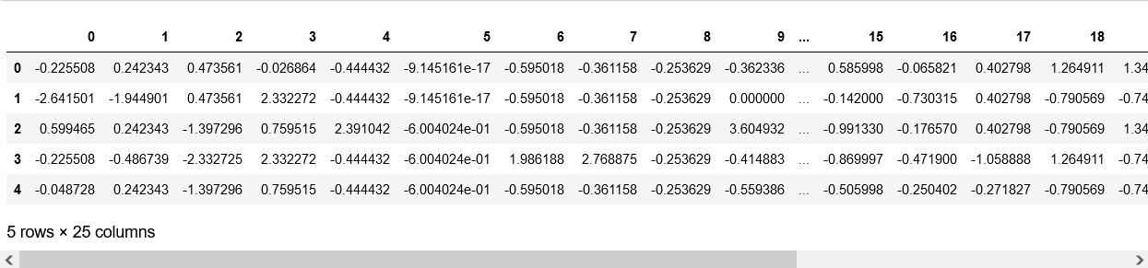
With Normalization
Scaling the dataset with Standard Scalar

Slide 52
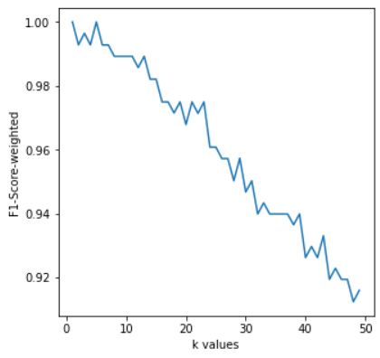
With Normalization
Optimal K = 1

Slide 53
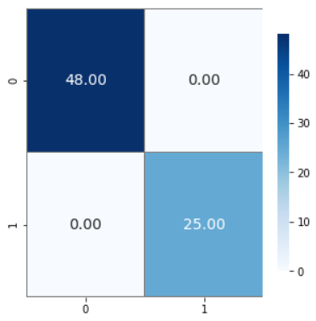
Confusion Matrix
 | Precision | Recall | F1 Score | Support
Not CKD | 1.0 | 1.0 | 1.0 | 25
CKD | 1.0 | 1.0 | 1.0 | 48
Accuracy |  |  |  | 73
Macro Avg | 1.0 | 1.0 | 1.0 | 73
Weighted Avg | 1.0 | 1.0 | 1.0 | 73

Slide 54
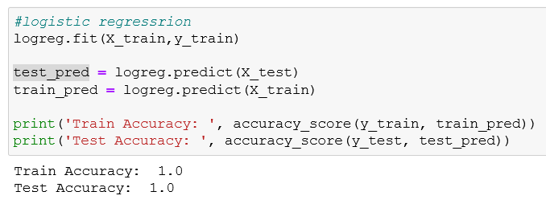
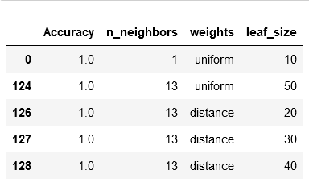
With Normalization

Slide 55
THANK YOU

